Slide 1
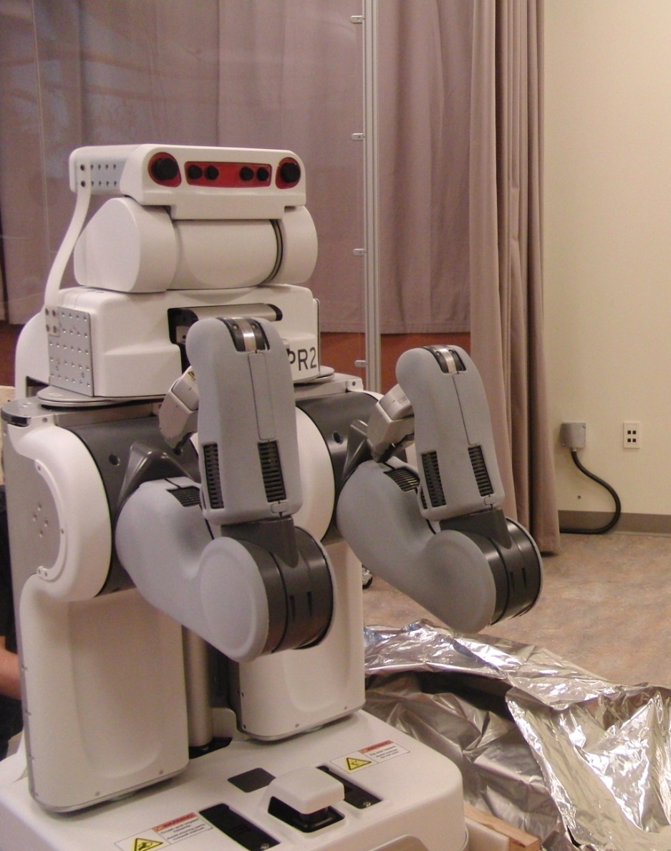
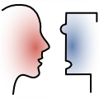
Hieu Nguyen
NSF Summer 2010 “REU Awardee”
USC Interaction Lab
Mentor: Aaron St. Clair
Advisor: Prof. Maja Mataric´
August 2, 2010
1/7
Notes:
Hi everyone, my name is Hieu.
This summer, I’ve been working with Aaron on a few projects, which involve his research interests of modeling and predicting human behavior and social dynamics in real-world environments. Some of the projects were small and simple, while others were lengthier and more difficult (in fact, I’m still stuck debugging some problems). These tasks kind of came together into a big project, which is the Deixis Experiment.

Slide 2
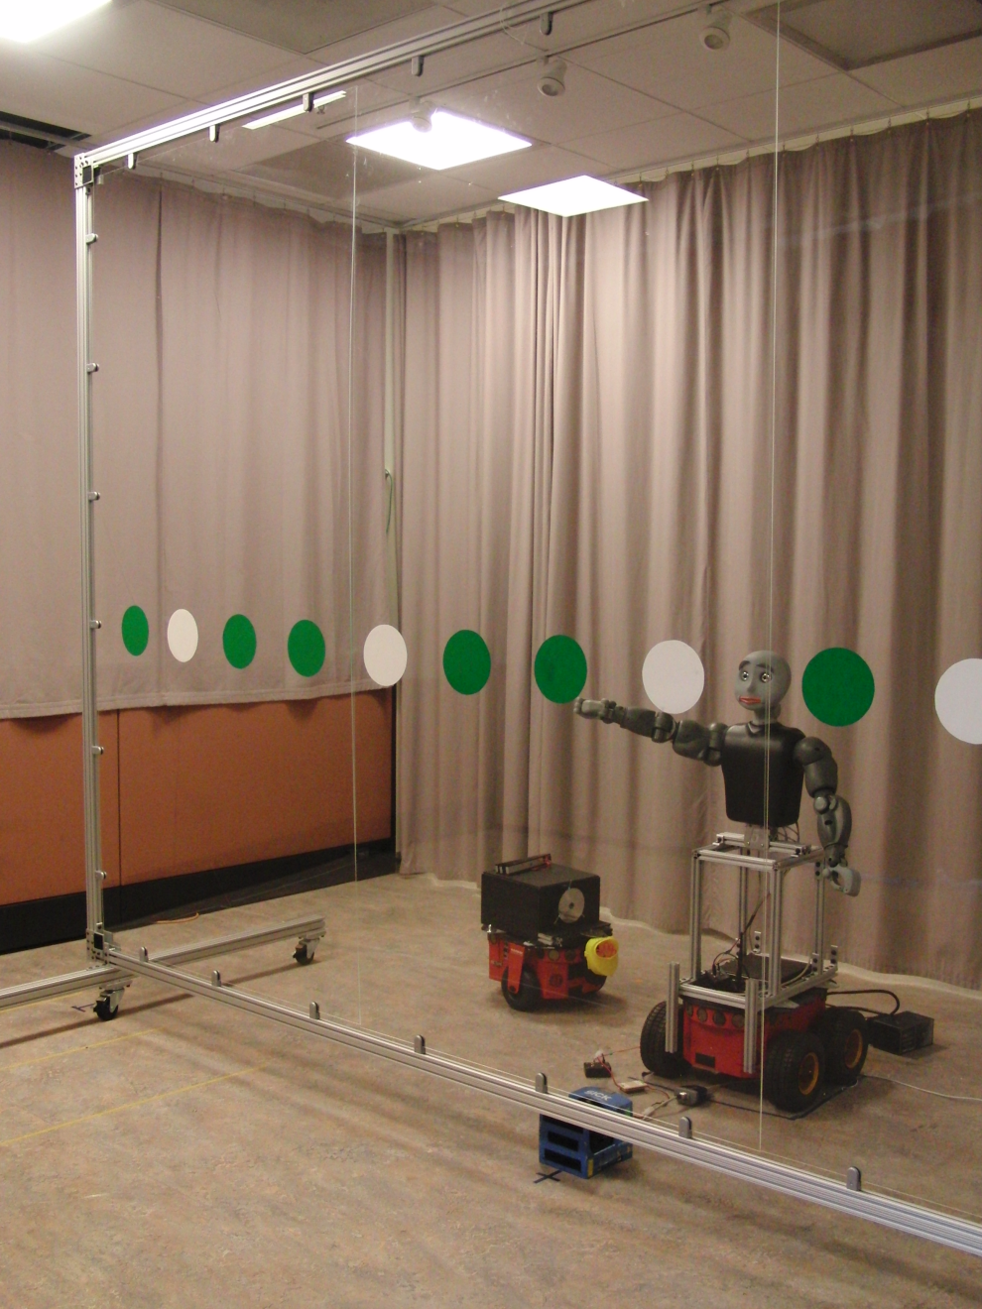
Deixis Experiment
A system for situated head and arm motion specification playback
Modeling human perception of robot pointing gestures
Hardware:
Bandit-II
SICK LMS
Point Grey Firefly MV Cameras
Nintendo Wiimote
Software:
deixis
marker_finder
Head-tracking (ARToolKit)
Joystick controller
2/7
Notes:
Unfortunately, I can’t reveal the full details of the experiment because I’m hoping that some of you will be participants in the study. And if I fill you in on the specifics, I would invalidate and bias the data.
At the basic level, Deixis is a human-robot interaction system for situated head and arm motion specification playback—it models human perception of robot pointing gestures. The experiment was developed by Ross and Aaron, and was actually conducted a few months ago. So, I spent this summer making some updates and modifications, and I’m getting ready to start running the experiments soon.
The experiment incorporates Bandit as the gesturing robot, which is controlled by the Deixis package that takes care of setting joint positions and logging data.
The SICK laser measurement sensor is used to find markers on the screen.
Point Grey Cameras record video for head-tracking with the ARToolKit.
And the Wiimote is used as a joystick controller to make it easier to facilitate the experiment (pressing buttons to control Bandit and logging data).
2

Slide 3
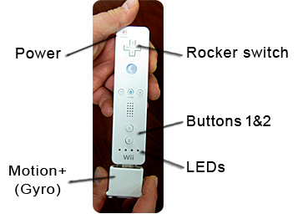
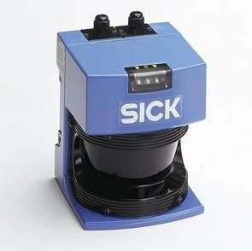
Wiimote and SICK LMS
ROS wiimote package
Bluetooth communication
Access to button, LED, rumble, and accelerometer/gyro data
Record waypoint coordinates, using rumble patterns for active feedback
Command Bandit to move through a random sequence
ROS sicktoolbox_wrapper
Display laser data in RViz
Launch files for logging data and recording waypoints
3/7
Notes:
I started off the summer programming for the wiimote. The ROS wiimote package allows ROS nodes to communicate with a Nintendo Wiimote through the ROS framework, using Bluetooth to obtain button, LED, rumble, and accelerometer data. I wrote a program to save waypoint coordinates using the wiimote controller. The logged waypoint coordinates are used in the Deixis experiment. Randomize
The wiimote program depends on sensor data from the SICK laser scanner to find markers.
I used the SICK Laser Measurement Sensor (LMS). All of the sensors operate by shining a laser off of a rotating mirror. As the mirror spins, the laser scans 180°, effectively creating a fan of laser light. Any object that breaks this fan reflects laser light back to the sensor. The distance is calculated based on how long the laser takes to bounce back to the sensor
Wrote launch files to start up logging and recording, loading dependencies and loading the correct configuration settings in RViz
3

Slide 4
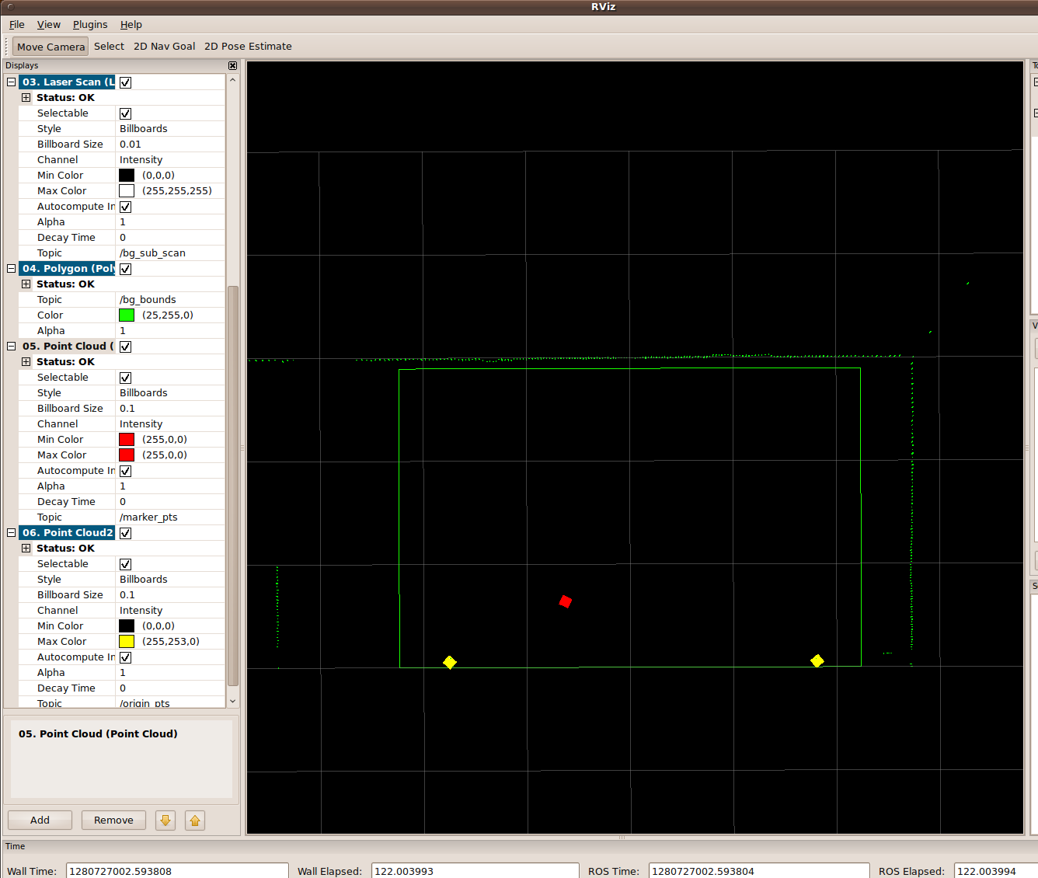
Visualizing in RViz
4/7
Notes:
This is a screenshot of the marker_finder running in Rviz. The polygon represents the screen, and the red point cloud is a waypoint to be recorded with the wiimote. You can also see the laser scan of the ceiling, wall, and cubicle area.

Slide 5
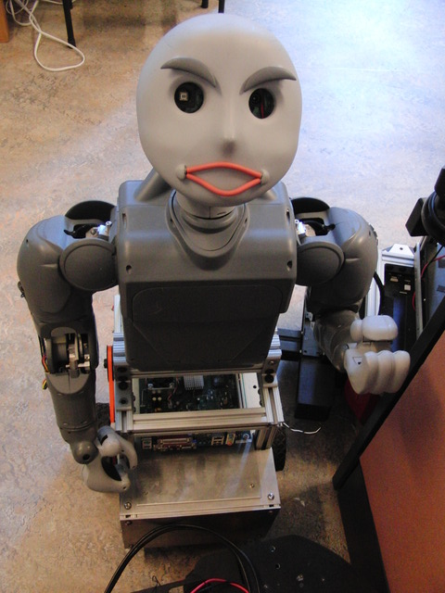
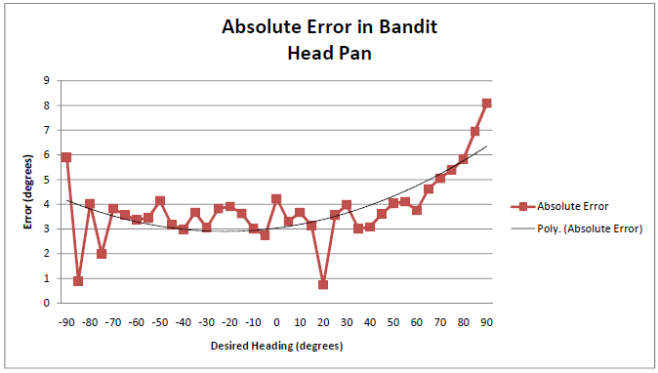
Challenges with Bandit
Bandit doesn’t point where he is commanded to point
Automated joint calibration
Servo motor encoders
Bandit Head/Arm Accuracy Analysis:
5/7
Notes:
Working with Bandit has been buggy… there are only 2 working Bandits now
The experiment was performed a few months ago, but several changes have been made to the bandit package, and recently, I have been working to accommodate Deixis for those changes
We tried using Charles’ automated joint calibration to calibrate to fix the error, but I narrowed down the issue to the encoders servo (reporting the wrong joint angles, or we are commanding it wrong)
Little r plots for arm
Dave asked me to plot out error in all joints
Here is what the head panning joint looks like
The idea is to account for the error
Need to check if commanding is wrong (since position looks correct)

Slide 6
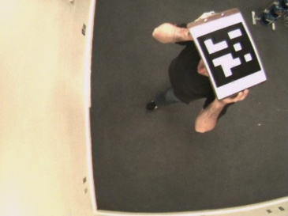
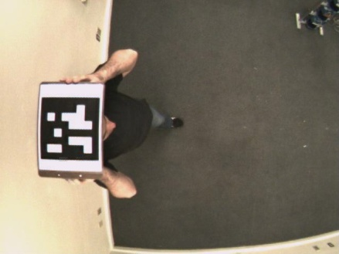
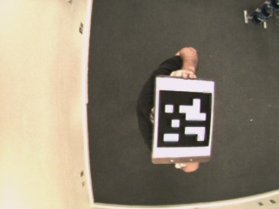
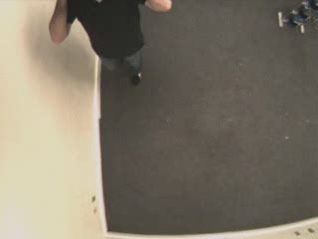
bag2video
Consumes a bag file of compressed images, then returns a .AVI video file
image_transport for publishing/subscribing to images between ROS nodes
CvBridge to convert between ROS image messages and OpenCV images
Functionality to create a video file at a variable framerate, given a directory of .JPG images
6/7
Notes:
The bag2video package is a utility that will consume a bag file of compressed images, and return a .avi file (hence the name, "bag2video"). It uses image_transport..., CVbridge to convert between ROS image and IPL image types, and openCV to write the video.
Users can specify the bagfile name, path to directory, and framerate in the command line
These videos have ARTags and the videos will be used for head-tracking using the ARToolkit
6

Slide 7
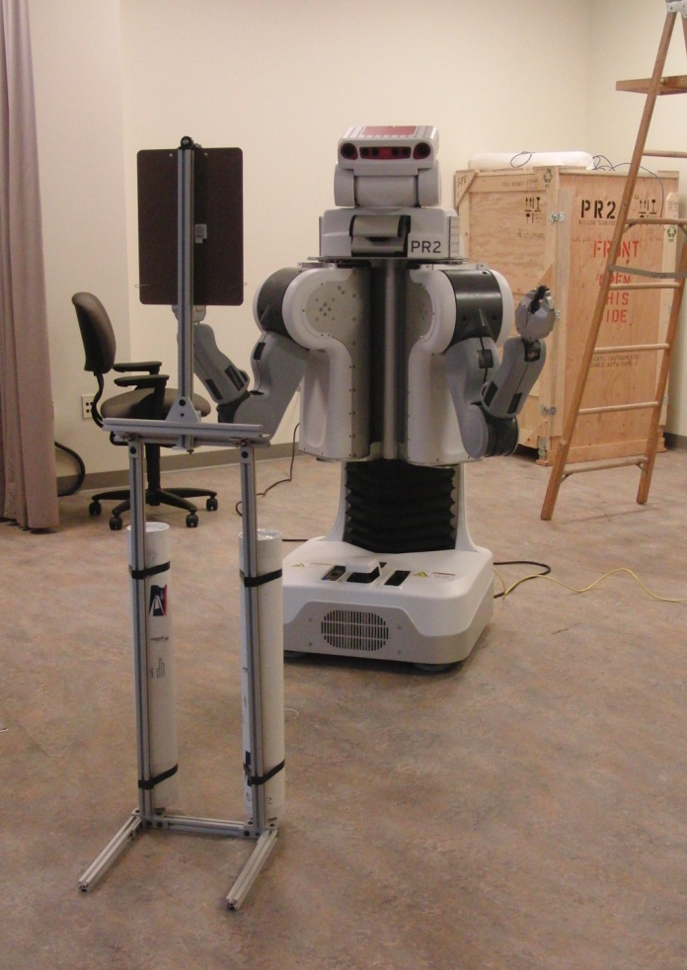
Thanks for listening.
QUESTIONS?
http://robotics.usc.edu/~hieu
7/7

